Slide 1
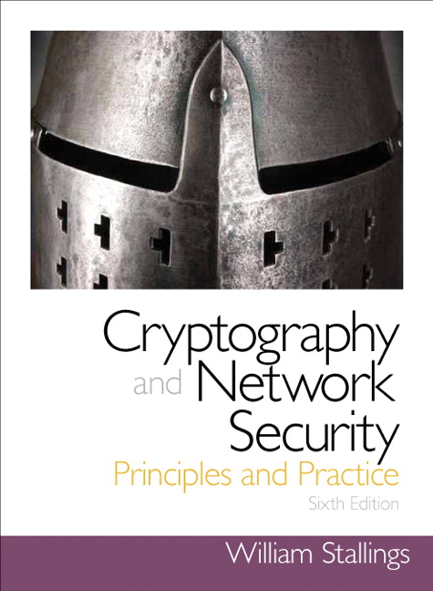
KERBEROS
User Authentication
Notes:
This chapter examines some of the authentication functions that have been developed
to support network-based use authentication. The chapter begins with an introduction
to some of the concepts and key considerations for user authentication over a network
or the Internet. The next section examines user-authentication protocols that rely on
symmetric encryption. This is followed by a section on one of the earliest and also one
of the most widely used authentication services: Kerberos. Next, the chapter looks at
user-authentication protocols that rely on asymmetric encryption. This is followed by a
discussion of the X.509 user-authentication protocol. Finally, the concept of federated
identity is introduced.

Slide 2
Remote User-Authentication Principles
The process of verifying an identity claimed by or for a system entity
An authentication process consists of two steps:
Identification step
Presenting an identifier to the security system
Verification step
Presenting or generating authentication information that corroborates the binding between the entity and the identifier
Notes:
For example, user Alice Toklas could have the user identifier ABTOKLAS.
This information needs to be stored on any server or computer system that
Alice wishes to use and could be known to system administrators and other
users. A typical item of authentication information associated with this user
ID is a password, which is kept secret (known only to Alice and to the system).
If no one is able to obtain or guess Alice’s password, then the combination of
Alice’s user ID and password enables administrators to set up Alice’s access permissions
and audit her activity. Because Alice’s ID is not secret, system users
can send her e-mail, but because her password is secret, no one can pretend to
be Alice.
In essence, identification is the means by which a user provides a claimed
identity to the system; user authentication is the means of establishing the validity
of the claim. Note that user authentication is distinct from message authentication.
As defined in Chapter 12, message authentication is a procedure that allows communicating
parties to verify that the contents of a received message have not been
altered and that the source is authentic. This chapter is concerned solely with user
authentication.

Slide 3
Means of User Authentication
For network-based user authentication, the most important methods involve cryptographic keys and something the individual knows, such as a password
There are four general means of authenticating a user’s identity, which can be used alone or in combination
Something the individual knows
Examples include a password, a personal identification number (PIN), or answers to a prearranged set of questions
Something the individual possesses
Examples include cryptographic keys, electronic keycards, smart cards, and physical keys
This is referred to as a token
Something the individual is (static biometrics)
Examples include recognition by fingerprint, retina, and face
Something the individual does (dynamic biometrics)
Examples include recognition by voice pattern, handwriting characteristics, and typing rhythm
Notes:
There are four general means of authenticating a user’s identity, which can be
used alone or in combination:
• Something the individual knows: Examples include a password, a personal
identification number (PIN), or answers to a prearranged set of questions.
• Something the individual possesses: Examples include cryptographic keys,
electronic keycards, smart cards, and physical keys. This type of authenticator
is referred to as a token .
• Something the individual is (static biometrics): Examples include recognition
by fingerprint, retina, and face.
• Something the individual does (dynamic biometrics): Examples include recognition
by voice pattern, handwriting characteristics, and typing rhythm.
All of these methods, properly implemented and used, can provide secure
user authentication. However, each method has problems. An adversary may be
able to guess or steal a password. Similarly, an adversary may be able to forge or
steal a token. A user may forget a password or lose a token. Furthermore, there is a
significant administrative overhead for managing password and token information
on systems and securing such information on systems. With respect to biometric authenticators,
there are a variety of problems, including dealing with false positives
and false negatives, user acceptance, cost, and convenience. For network-based user
authentication, the most important methods involve cryptographic keys and something
the individual knows, such as a password.

Slide 4
Kerberos
Authentication service developed as part of Project Athena at MIT
A workstation cannot be trusted to identify its users correctly to network services
A user may gain access to a particular workstation and pretend to be another user operating from that workstation
A user may alter the network address of a workstation so that the requests sent from the altered workstation appear to come from the impersonated workstation
A user may eavesdrop on exchanges and use a replay attack to gain entrance to a server or to disrupt operations
Kerberos provides a centralized authentication server whose function is to authenticate users to servers and servers to users
Relies exclusively on symmetric encryption, making no use of public-key encryption
Notes:
Kerberos is an authentication service developed as part of Project Athena at MIT.
The problem that Kerberos addresses is this: Assume an open distributed environment
in which users at workstations wish to access services on servers distributed
throughout the network. We would like for servers to be able to restrict access to
authorized users and to be able to authenticate requests for service. In this environment,
a workstation cannot be trusted to identify its users correctly to network
services. In particular, the following three threats exist:
1. A user may gain access to a particular workstation and pretend to be another
user operating from that workstation.
2. A user may alter the network address of a workstation so that the requests
sent from the altered workstation appear to come from the impersonated
workstation.
3. A user may eavesdrop on exchanges and use a replay attack to gain entrance
to a server or to disrupt operations.
In any of these cases, an unauthorized user may be able to gain access to services
and data that he or she is not authorized to access. Rather than building in elaborate
authentication protocols at each server, Kerberos provides a centralized authentication
server whose function is to authenticate users to servers and servers to users.
Unlike most other authentication schemes described in this book, Kerberos relies
exclusively on symmetric encryption, making no use of public-key encryption.
Two versions of Kerberos are in common use. Version 4 [MILL88, STEI88]
implementations still exist. Version 5 [KOHL94] corrects some of the security deficiencies
of version 4 and has been issued as a proposed Internet Standard (RFC 4120
and RFC 4121).

Slide 5
Kerberos
Kerberos is a computer network authentication protocol that works on the basis of tickets to allow nodes communicating over a non-secure network to prove their identity to one another in a secure manner.
Its designers aimed it primarily at a client–server model and it provides mutual authentication—both the user and the server verify each other's identity.

Slide 6
Kerberos
The Kerberos concept uses a "master ticket" obtained at logon, which is used to obtain additional "service tickets" when a particular resource is required.
When users log in to a Kerberos system, their password is encrypted and sent to the authentication service in the Key Distribution Center (KDC).

Slide 7
Kerberos
If successfully authenticated, the KDC creates a master ticket that is sent back to the user's machine.
Each time the user wants access to a service, the master ticket is presented to the KDC in order to obtain a service ticket for that service.
The master-service ticket method keeps the password more secure by sending it only once at logon. From then on, service tickets are used, which function like session keys.

Slide 8
Kerberos Version 4
Makes use of DES to provide the authentication service
Authentication server (AS)
Knows the passwords of all users and stores these in a centralized database
Shares a unique secret key with each server
Ticket
Created once the AS accepts the user as authentic; contains the user’s ID and network address and the server’s ID
Encrypted using the secret key shared by the AS and the server
Ticket-granting server (TGS)
Issues tickets to users who have been authenticated to AS
Each time the user requires access to a new service the client applies to the TGS using the ticket to authenticate itself
The TGS then grants a ticket for the particular service
The client saves each service-granting ticket and uses it to authenticate its user to a server each time a particular service is requested
Notes:
Version 4 of Kerberos makes use of DES, in a rather elaborate protocol, to provide
the authentication service. Viewing the protocol as a whole, it is difficult to see the
need for the many elements contained therein. Therefore, we adopt a strategy used
by Bill Bryant of Project Athena [BRYA88] and build up to the full protocol by looking
first at several hypothetical dialogues. Each successive dialogue adds additional
complexity to counter security vulnerabilities revealed in the preceding dialogue.
In an unprotected network environment, any
client can apply to any server for service. The obvious security risk is that of impersonation.
An opponent can pretend to be another client and obtain unauthorized
privileges on server machines. To counter this threat, servers must be able to
confirm the identities of clients who request service. Each server can be required to
undertake this task for each client/server interaction, but in an open environment,
this places a substantial burden on each server.
An alternative is to use an authentication server (AS) that knows the passwords
of all users and stores these in a centralized database. In addition, the AS
shares a unique secret key with each server. These keys have been distributed physically
or in some other secure manner.
The AS checks its database to see if the user has supplied the proper
password for this user ID and whether this user is permitted access to server V. If
both tests are passed, the AS accepts the user as authentic and must now convince
the server that this user is authentic. To do so, the AS creates a ticket that contains
the user’s ID and network address and the server’s ID. This ticket is encrypted
using the secret key shared by the AS and this server.
TGS, issues tickets to users who have been authenticated to
AS. Thus, the user first requests a ticket-granting ticket from the AS. The
client module in the user workstation saves this ticket. Each time the user requires
access to a new service, the client applies to the TGS, using the ticket to authenticate
itself. The TGS then grants a ticket for the particular service. The client saves
each service-granting ticket and uses it to authenticate its user to a server each time
a particular service is requested.
Because only the correct user should know the password, only the correct user
can recover the ticket. Thus, we have used the password to obtain credentials from
Kerberos without having to transmit the password in plaintext. The ticket itself
consists of the ID and network address of the user, and the ID of the TGS. This
corresponds to the first scenario. The idea is that the client can use this ticket to
request multiple service-granting tickets. So the ticket-granting ticket is to be reusable.
However, we do not wish an opponent to be able to capture the ticket and
use it. Consider the following scenario: An opponent captures the login ticket and
waits until the user has logged off his or her workstation. Then the opponent either
gains access to that workstation or configures his workstation with the same network
address as that of the victim. The opponent would be able to reuse the ticket
to spoof the TGS. To counter this, the ticket includes a timestamp, indicating the
date and time at which the ticket was issued, and a lifetime, indicating the length
of time for which the ticket is valid (e.g., eight hours). Thus, the client now has a
reusable ticket and need not bother the user for a password for each new service
request. Finally, note that the ticket-granting ticket is encrypted with a secret key
known only to the AS and the TGS. This prevents alteration of the ticket. The ticket
is reencrypted with a key based on the user’s password. This assures that the ticket
can be recovered only by the correct user, providing the authentication.
The service-granting ticket has the same structure as the ticket-granting ticket.
Indeed, because the TGS is a server, we would expect that the same elements are
needed to authenticate a client to the TGS and to authenticate a client to an application
server. Again, the ticket contains a timestamp and lifetime. If the user wants
access to the same service at a later time, the client can simply use the previously
acquired service-granting ticket and need not bother the user for a password. Note
that the ticket is encrypted with a secret key known only to the TGS and the
server, preventing alteration.

Slide 9
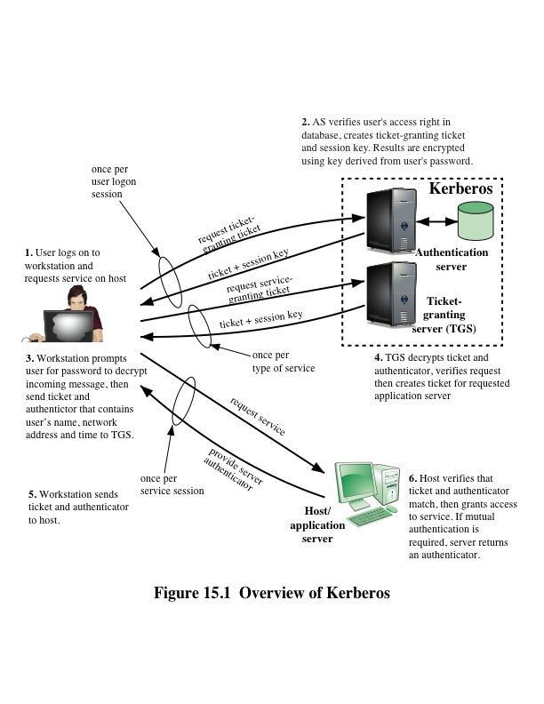
Notes:
Figure 15.1 provides an overview.
First, consider the problem of captured ticket-granting tickets and the need
to determine that the ticket presenter is the same as the client for whom the ticket
was issued. The threat is that an opponent will steal the ticket and use it before it
expires. To get around this problem, let us have the AS provide both the client and
the TGS with a secret piece of information in a secure manner. Then the client can
prove its identity to the TGS by revealing the secret information—again in a secure
manner. An efficient way of accomplishing this is to use an encryption key as the
secure information; this is referred to as a session key in Kerberos.

Slide 10
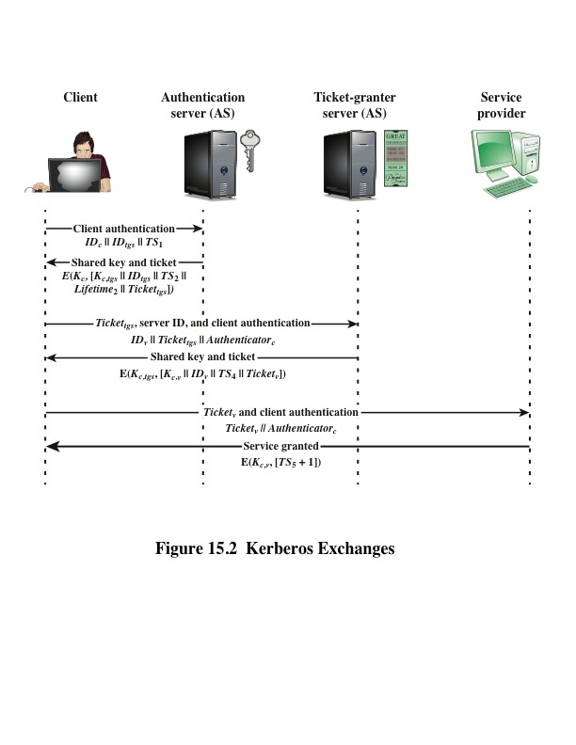
Notes:
Figure 15.2 illustrates the Kerberos exchanges among the parties.

